Slide 1



App development with Swift
Hayden & Dipesh

Slide 2
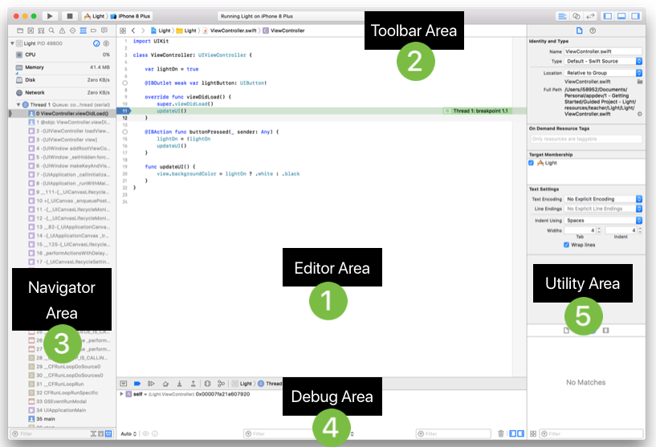
Notes:
Editor Area – Edit your source code, Add breakpoints.
Toolbar Area – Build and run
Navigator Area – See project structure
Debug Area – Console area and add print statements as well.
Utility area - Add components and information about your view controller.

Slide 3
Notes:
Warning’s don’t prevent your code from running, think of a switch case scenario you saw last week. We had a fixed input and it threw a warning but we were still able to see the result. For example:
Compiler errors, or an exception, is indicative of a more serious issue
Dot center error (Displays a suggestion to fix the code)
Exclamation point center. No fix-it, but it does provide a message that can help identify the issue.
Bug much harder to find.
Step over button.

Slide 4
Notes:
When most people here bugs, or debugging for the first time this might be what they are thinking of! But it’s far less physical than that.

